Slide 1
The Tool You Never Knew You Needed
An Introduction to Application Insights

Slide 2



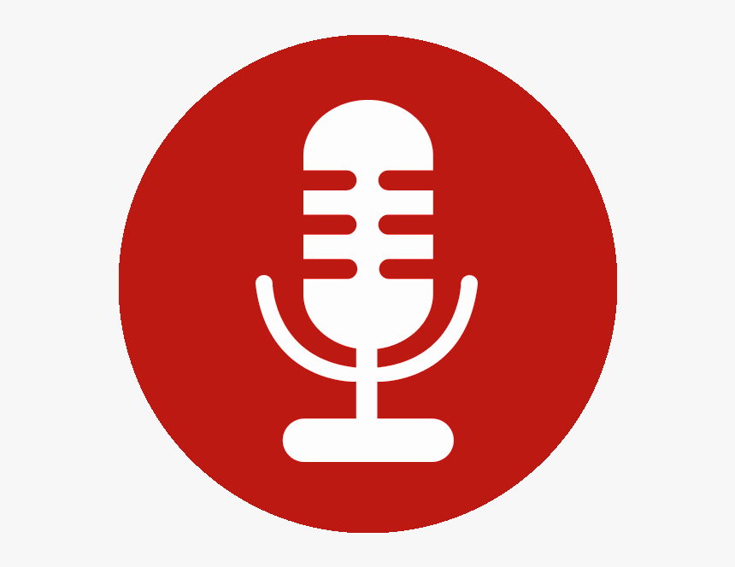






https://www.isaaclevin.com
@isaacrlevin
https://www.coffeeandopensource.com
@isaacrlevin
@isaacrlevin@fosstodon.org

Slide 3
Quick Poll
Telemetry?

Slide 4
Quick Poll
Who writes Web Apps (client,server,both)?
Who has apps deployed to the cloud? On-Prem?
Who uses an APM (Elastic, New Relic, App Dynamics)?
Who rolls own Telemetry Collection (NLog, Serilog, log4net)?
Who knows/uses Application Insights?

Slide 5
Questions To Consider
What could we do with all the data our application creates/uses?
How much easier would our lives be if we could chart the path of a request frequently used and spend little time doing it?
Which kinds of reports regarding usage would our stakeholders most benefit from?

Slide 6








What is App Insights?
Notes:
Application Insights is an extensible Application Performance Management (APM) service for web developers on multiple platforms. Use it to monitor your live web application. It will automatically detect performance anomalies. It includes powerful analytics tools to help you diagnose issues and to understand what users actually do with your app. It's designed to help you continuously improve performance and usability. It works for apps on a wide variety of platforms including .NET, Node.js and J2EE, hosted on-premises or in the cloud. It integrates with your DevOps process, and has connection points to a variety of development tools. It can monitor and analyze telemetry from mobile apps by integrating with Visual Studio App Center and HockeyApp.

Slide 7
What Kind of Telemetry?
Request/Response Information
Dependencies (SQL, 3rd Parties)
Page Views/Load
User Information
Exceptions
Performance Data
Everything Else

Slide 8

Flow of Application Insights
Notes:
You install a small instrumentation package in your application, and set up an Application Insights resource in the Microsoft Azure portal. The instrumentation monitors your app and sends telemetry data to the portal. (The application can run anywhere - it doesn't have to be hosted in Azure.)
You can instrument not only the web service application, but also any background components, and the JavaScript in the web pages themselves.
In addition, you can pull in telemetry from the host environments such as performance counters, Azure diagnostics, or Docker logs. You can also set up web tests that periodically send synthetic requests to your web service.+
All these telemetry streams are integrated in the Azure portal, where you can apply powerful analytic and search tools to the raw data.

Slide 9
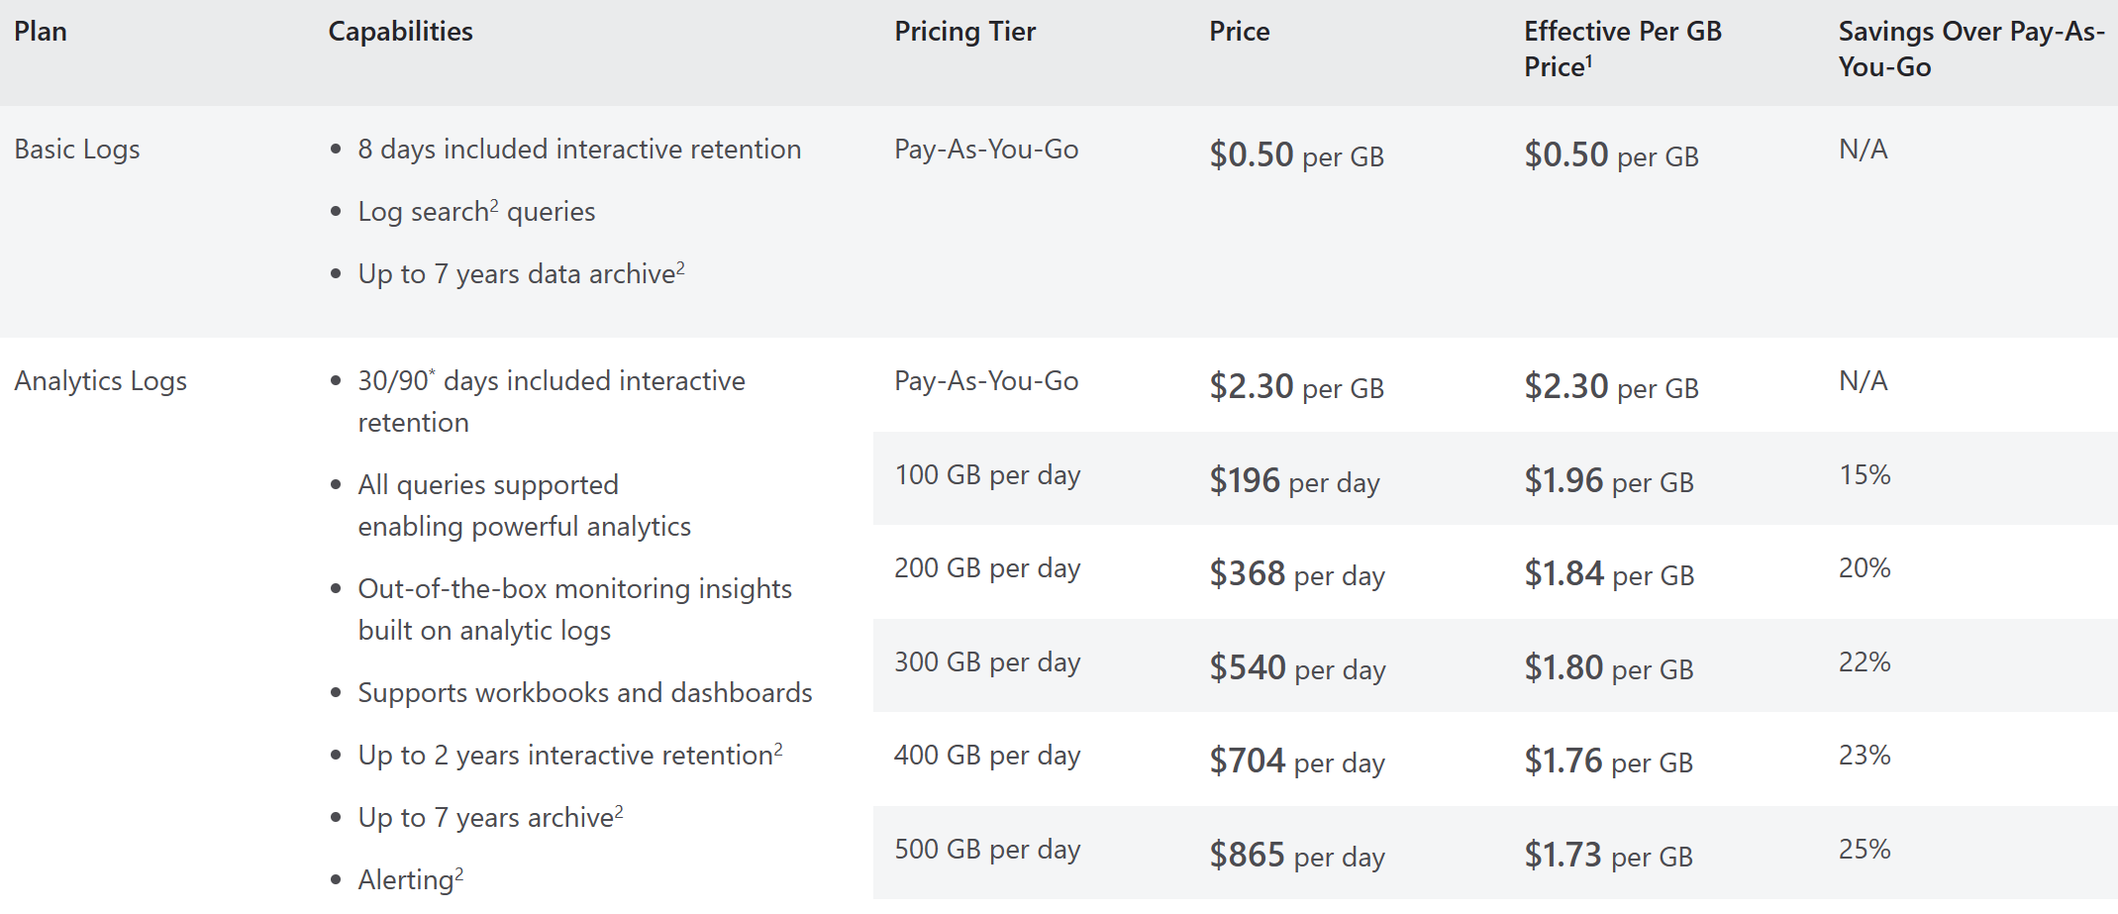
Ok, I am Interested… How Much?
Application Insights Status Monitor (for IIS Servers like on-prem)

Slide 10
How do I Instrument?

Slide 11
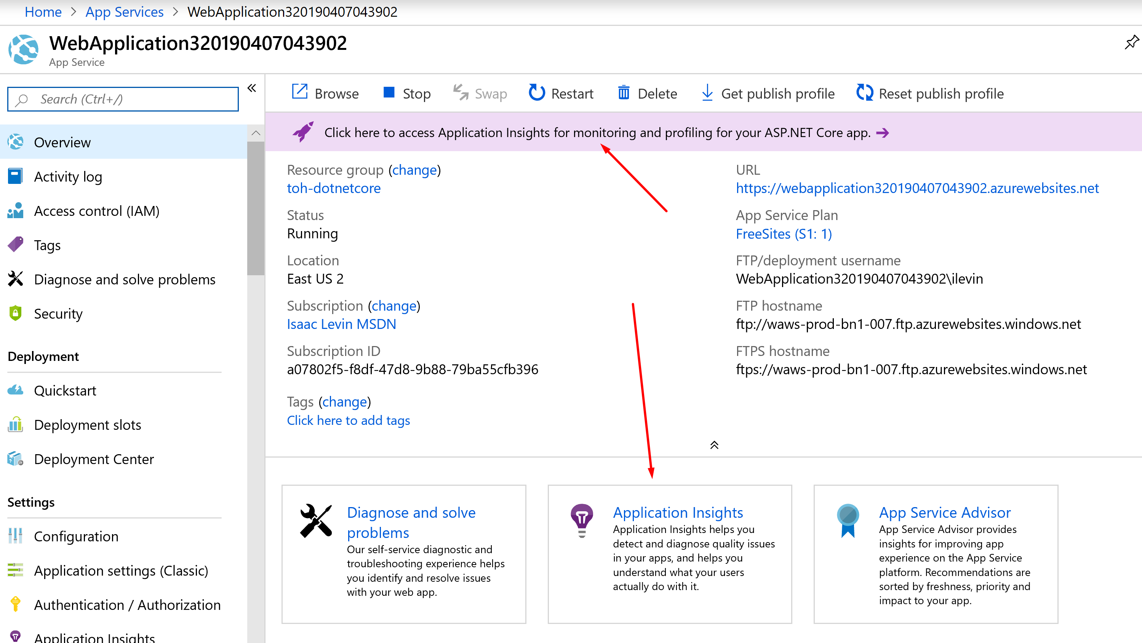
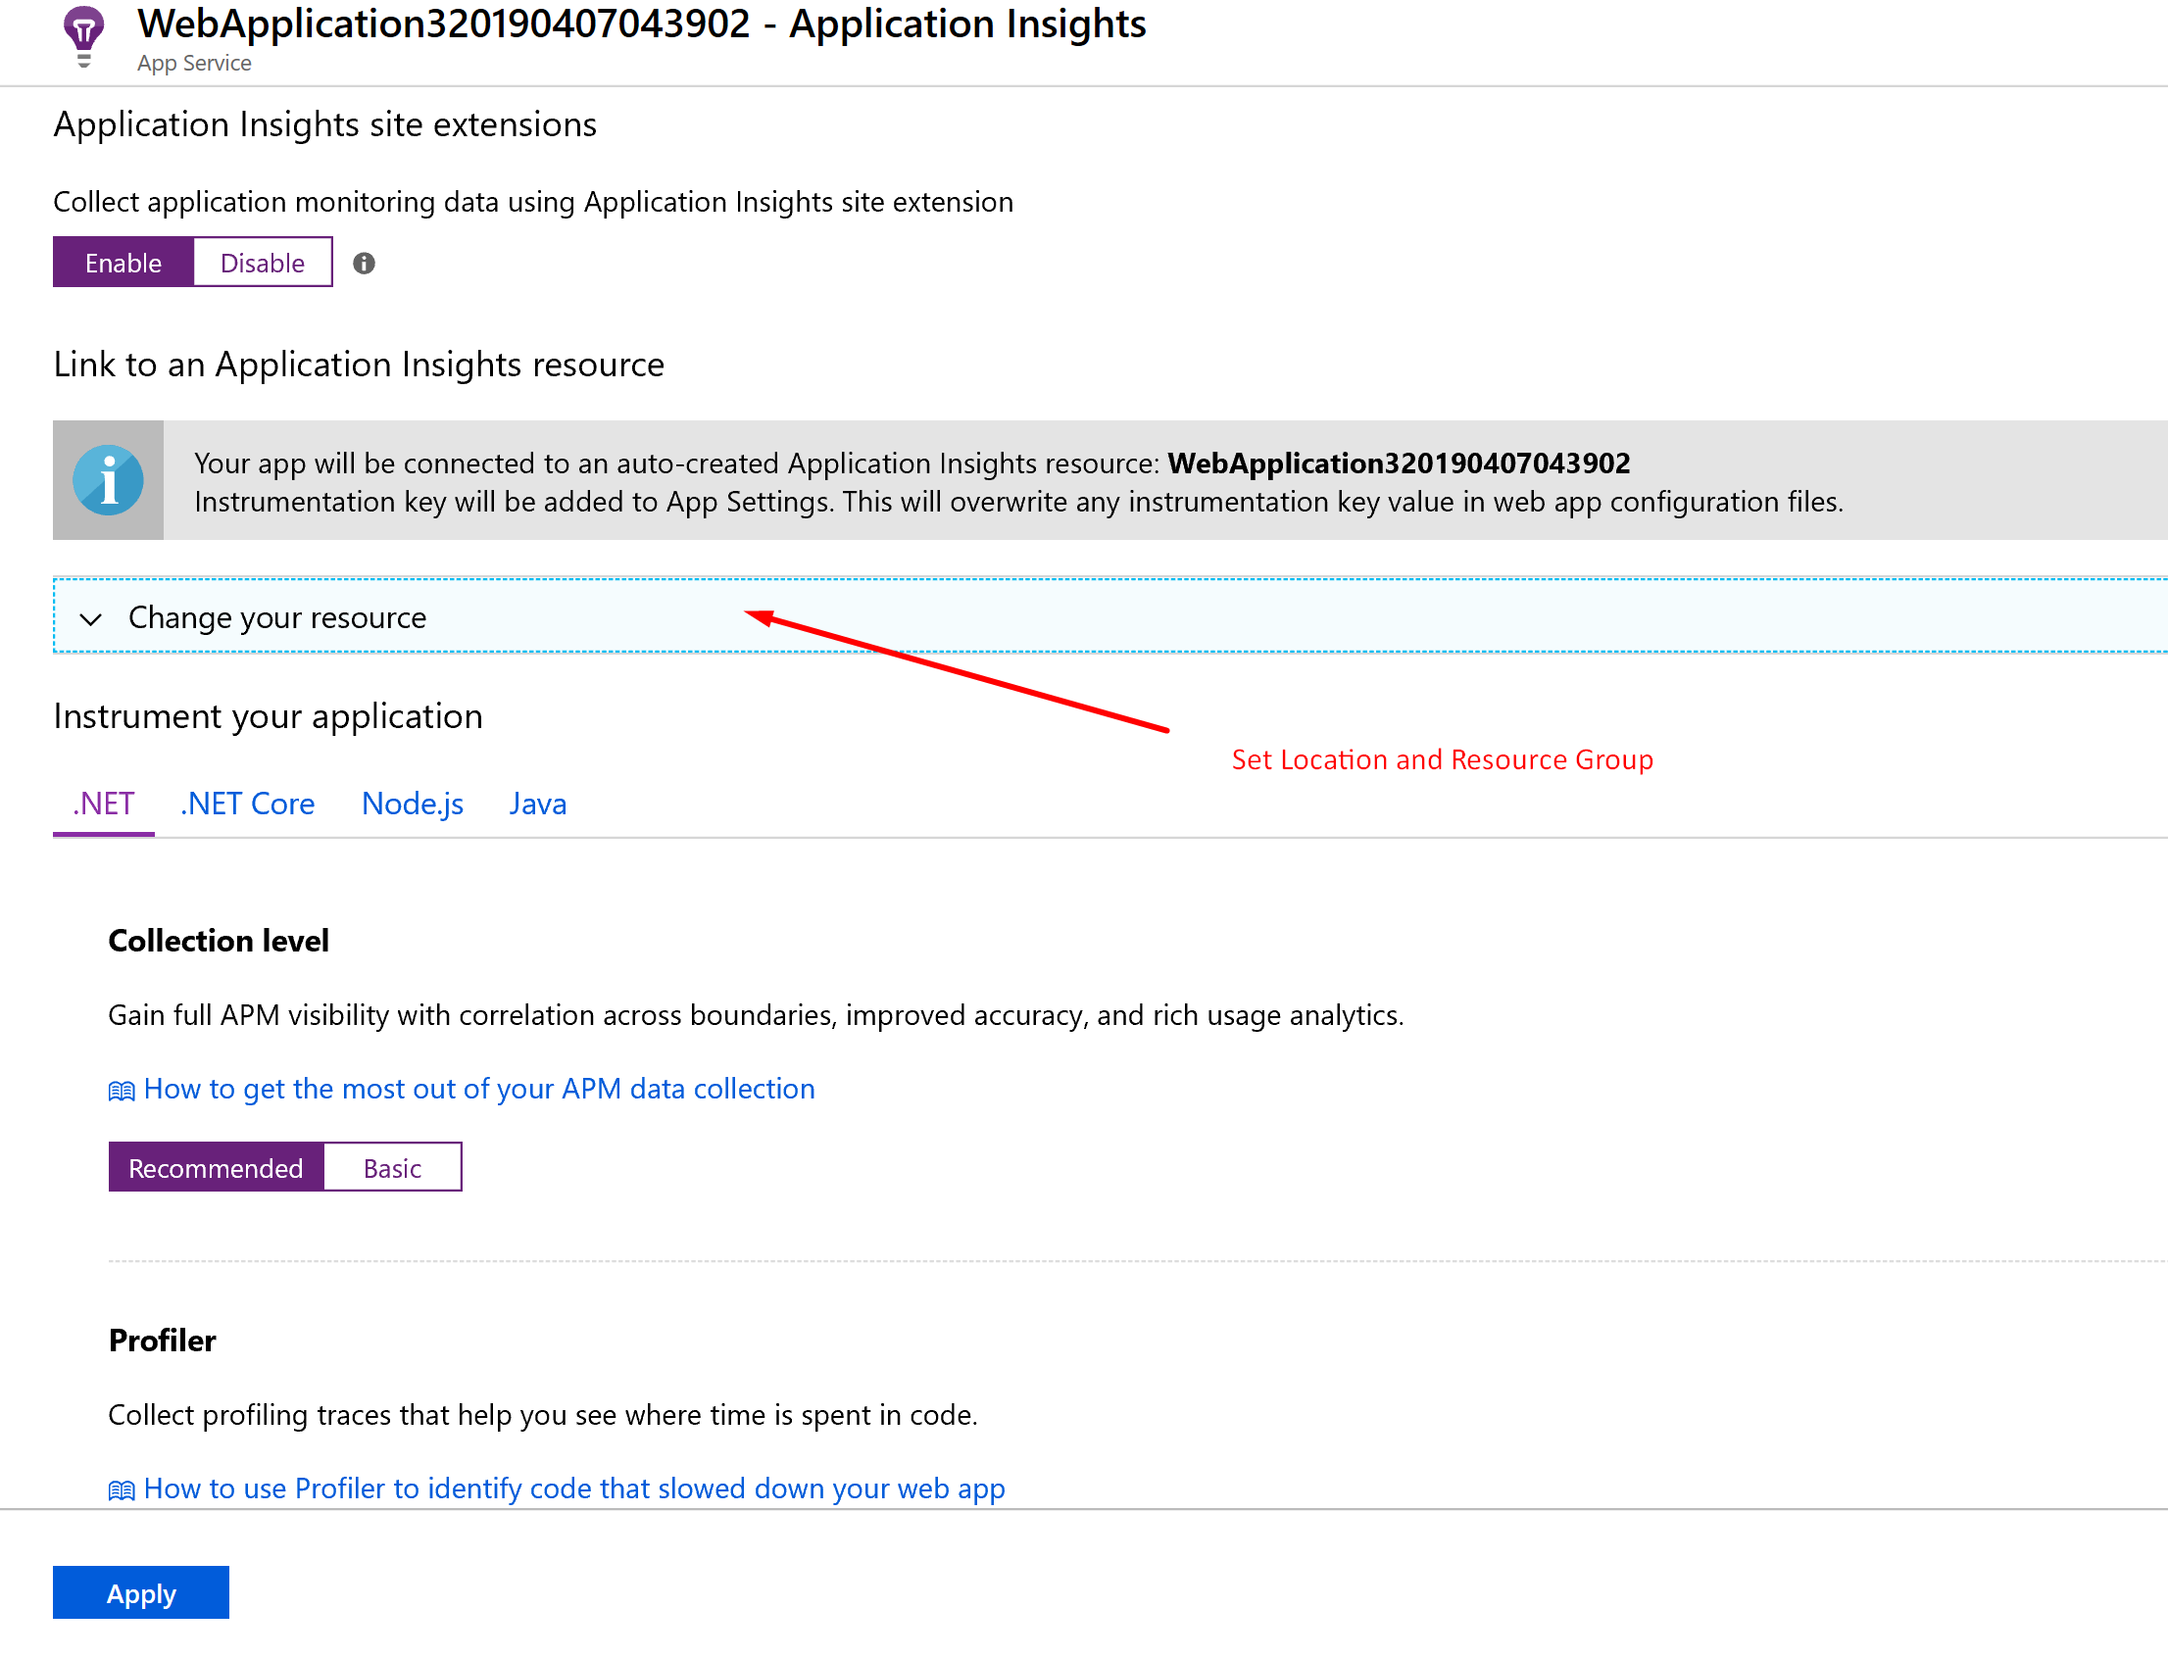
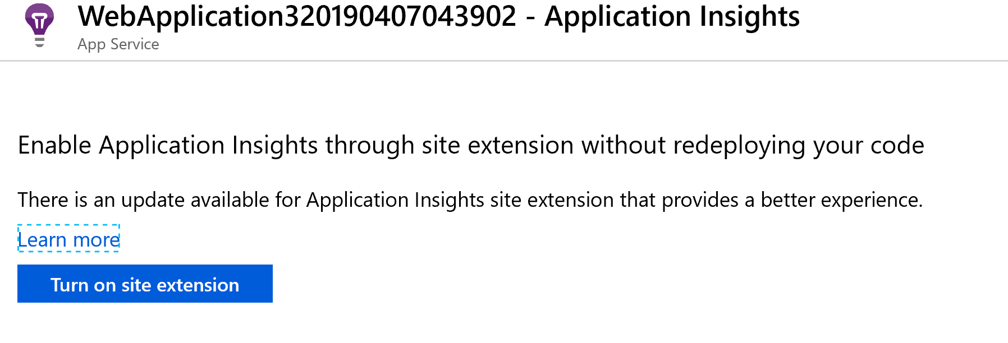
Setting Up Your App
Application Insights Status Monitor (for IIS Servers like on-prem)
Enable Extension on App Service Directly

Slide 12
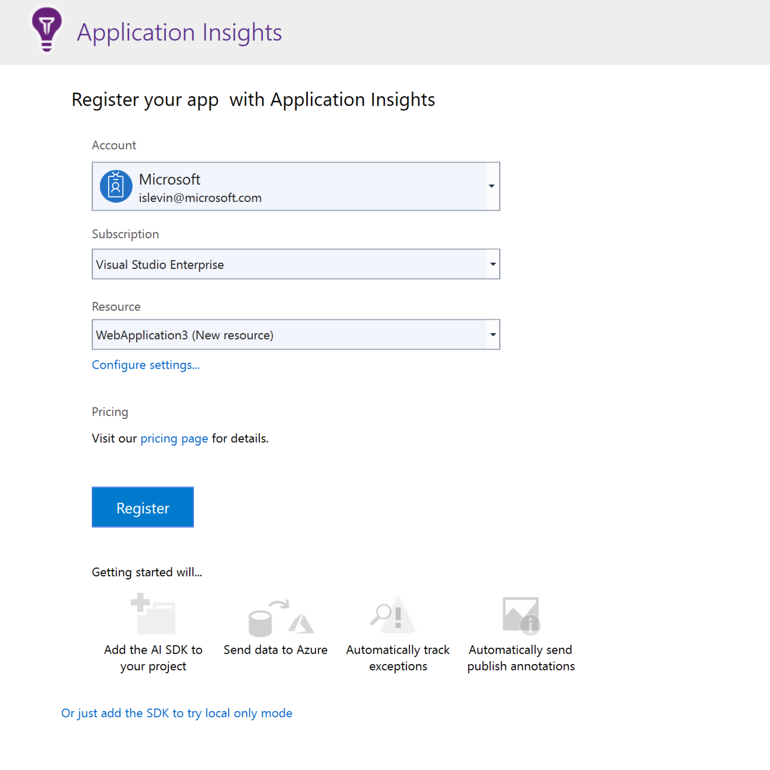
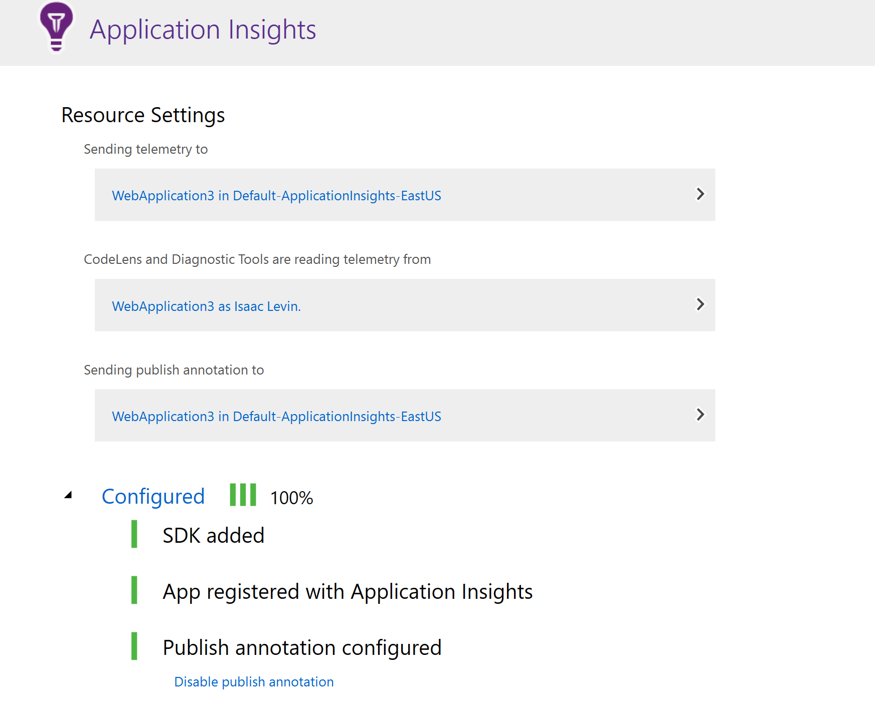
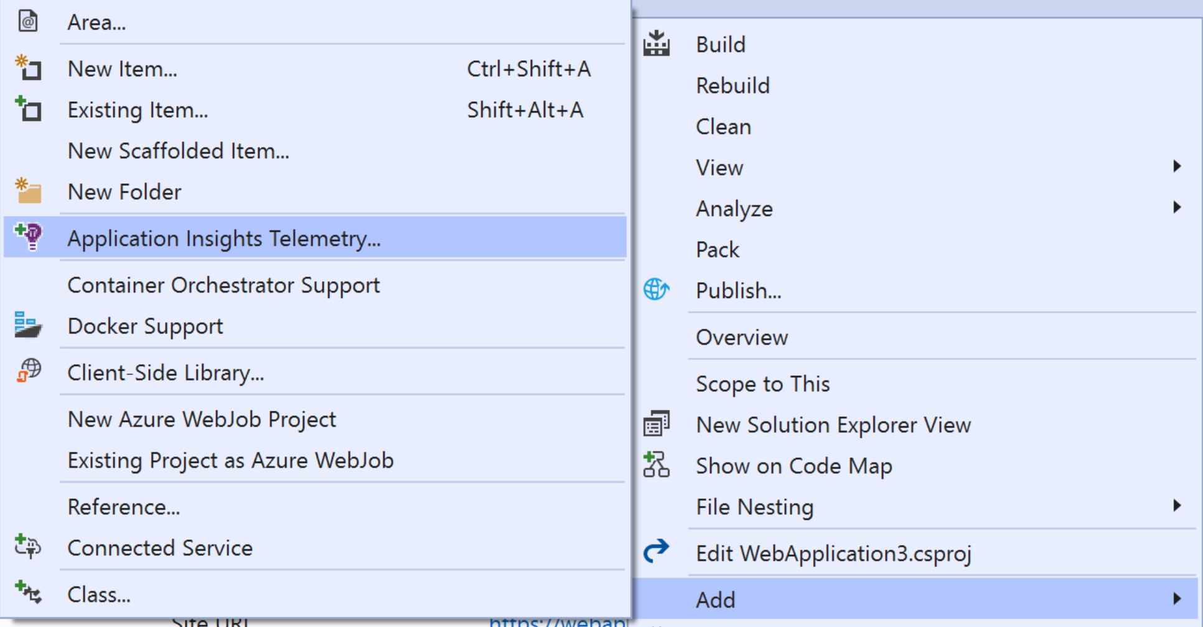
Setting Up Your App
Application Insights Status Monitor (for IIS Servers like on-prem)
Configure Using Visual Studio

Slide 13
Setting Up Your App
Application Insights Status Monitor
PowerShell Module
Codeless Instrumentation of .NET Web Apps hosted in IIS
API commands to “turn on features”
Application Insights Status Monitor (for IIS Servers like on-prem)
What about IIS?

Slide 14
Setting up App Insights
Demo

Slide 15
What do I do with this data?

Slide 16
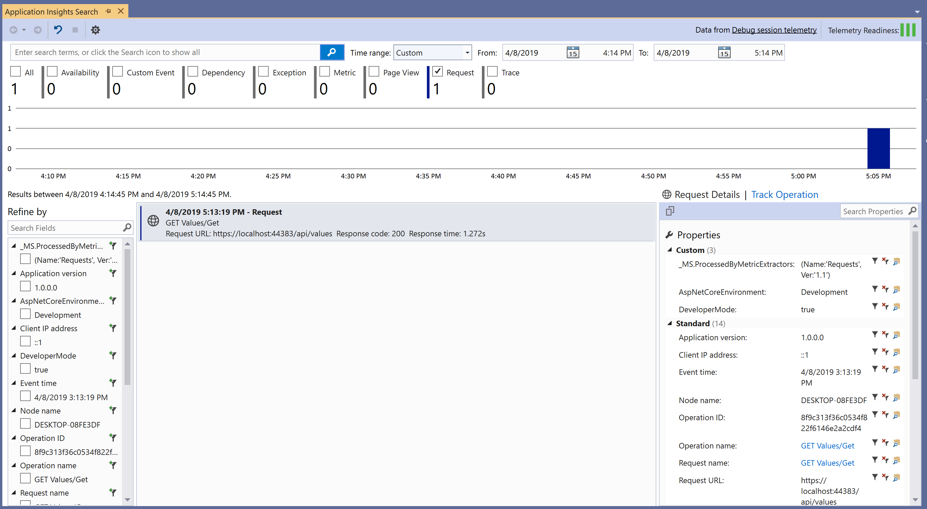
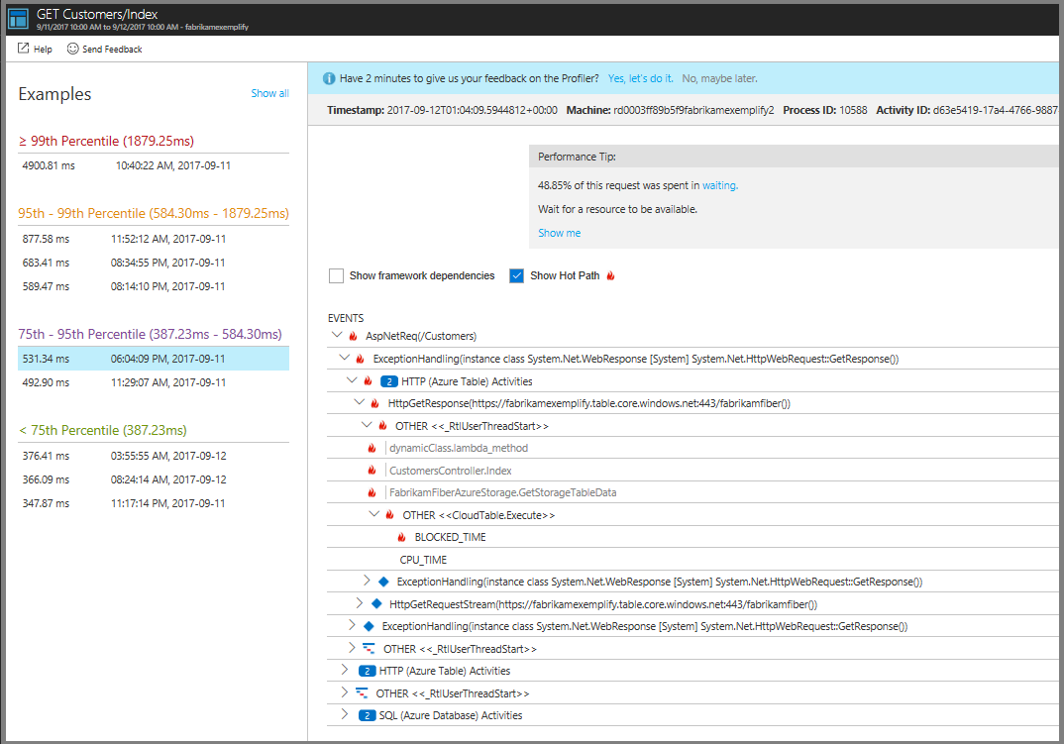
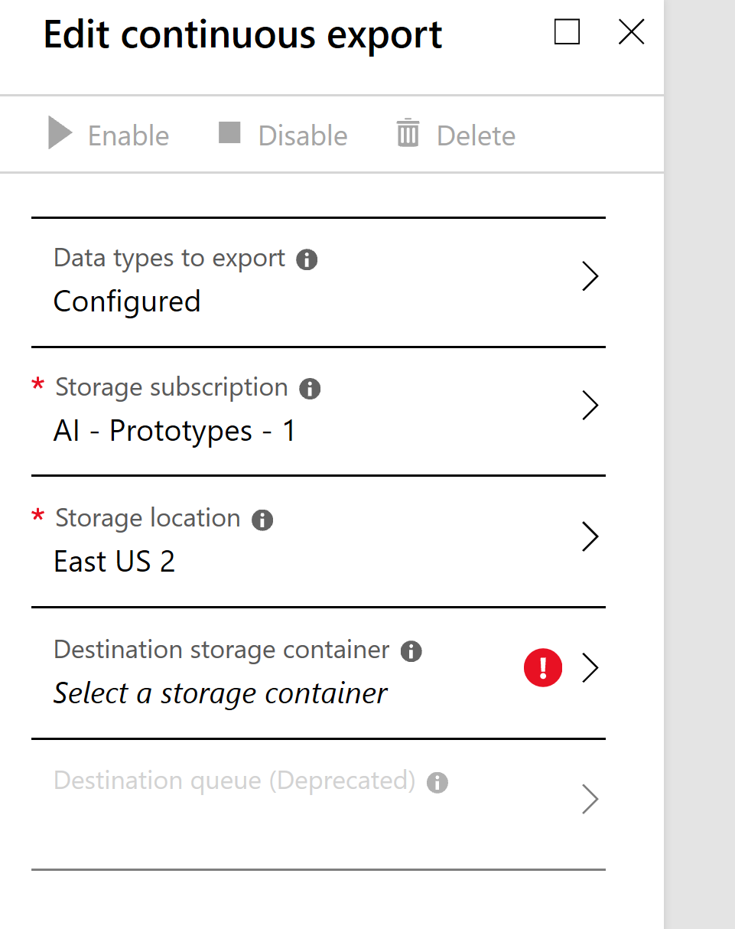
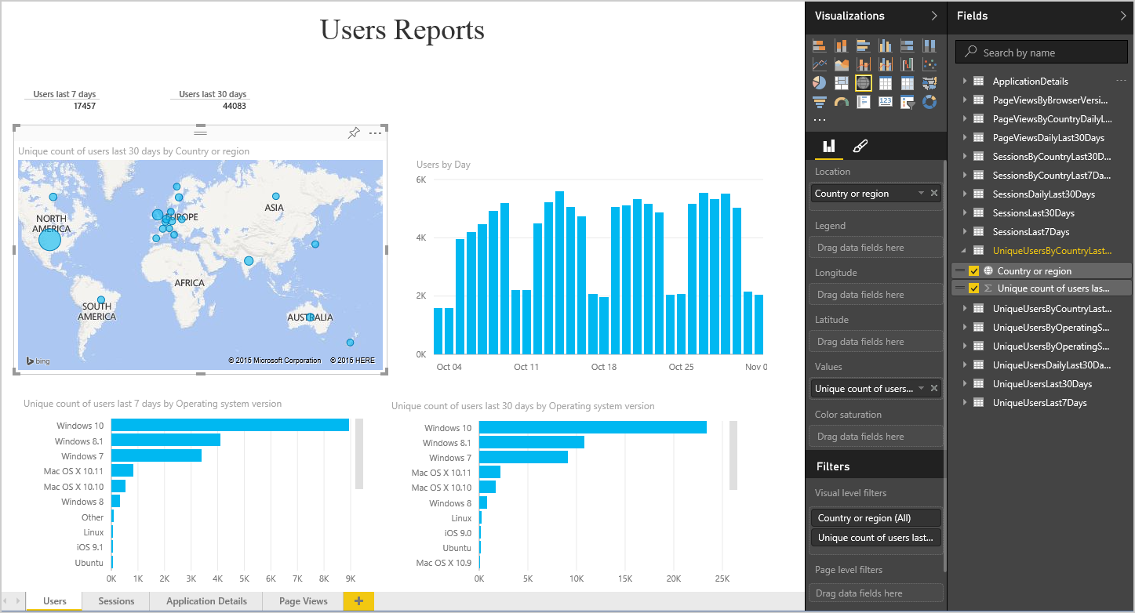
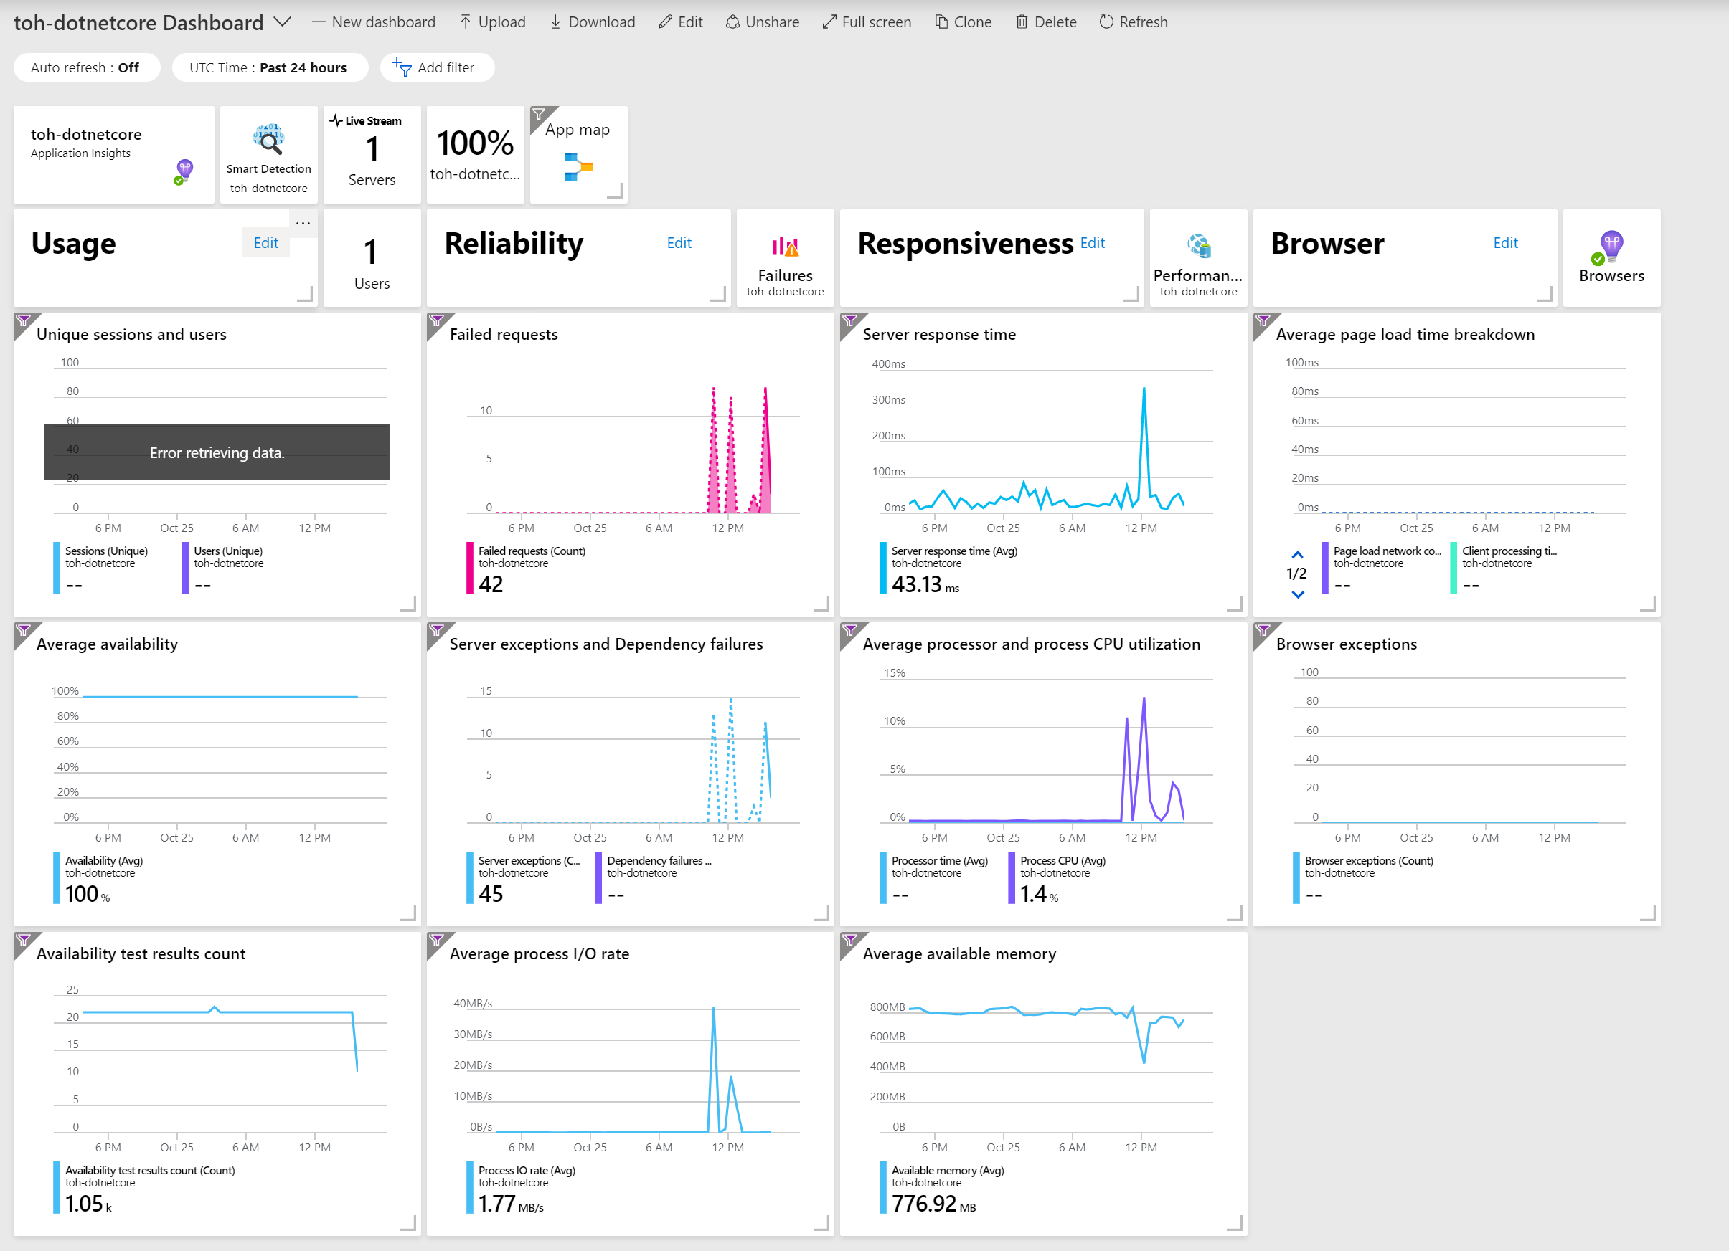
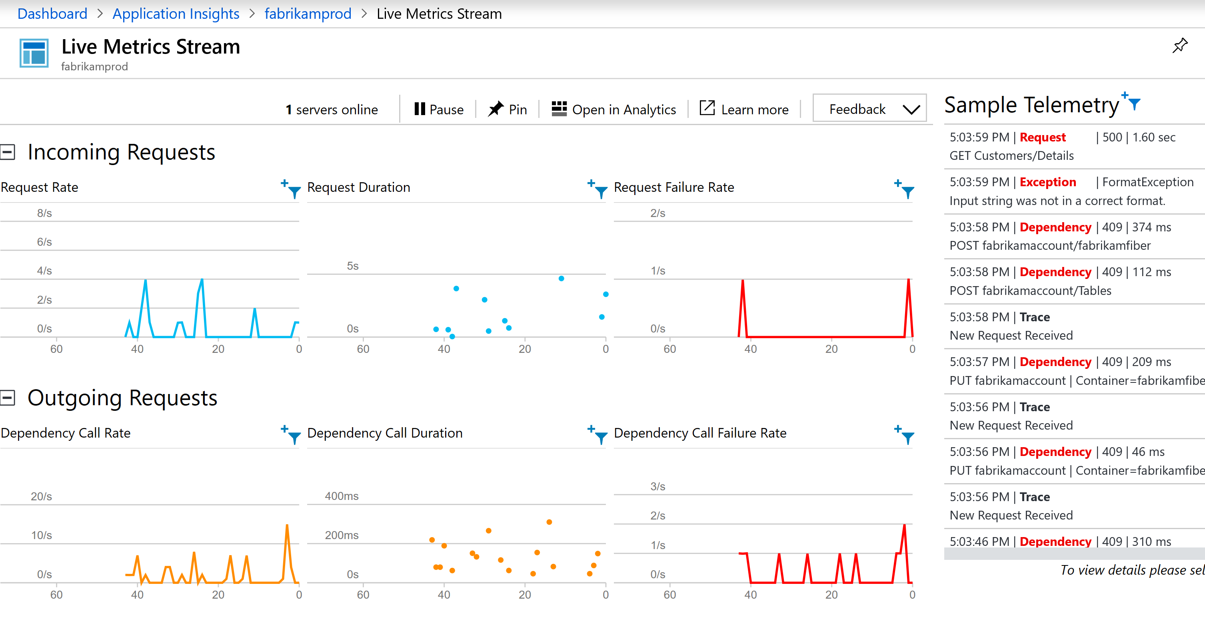
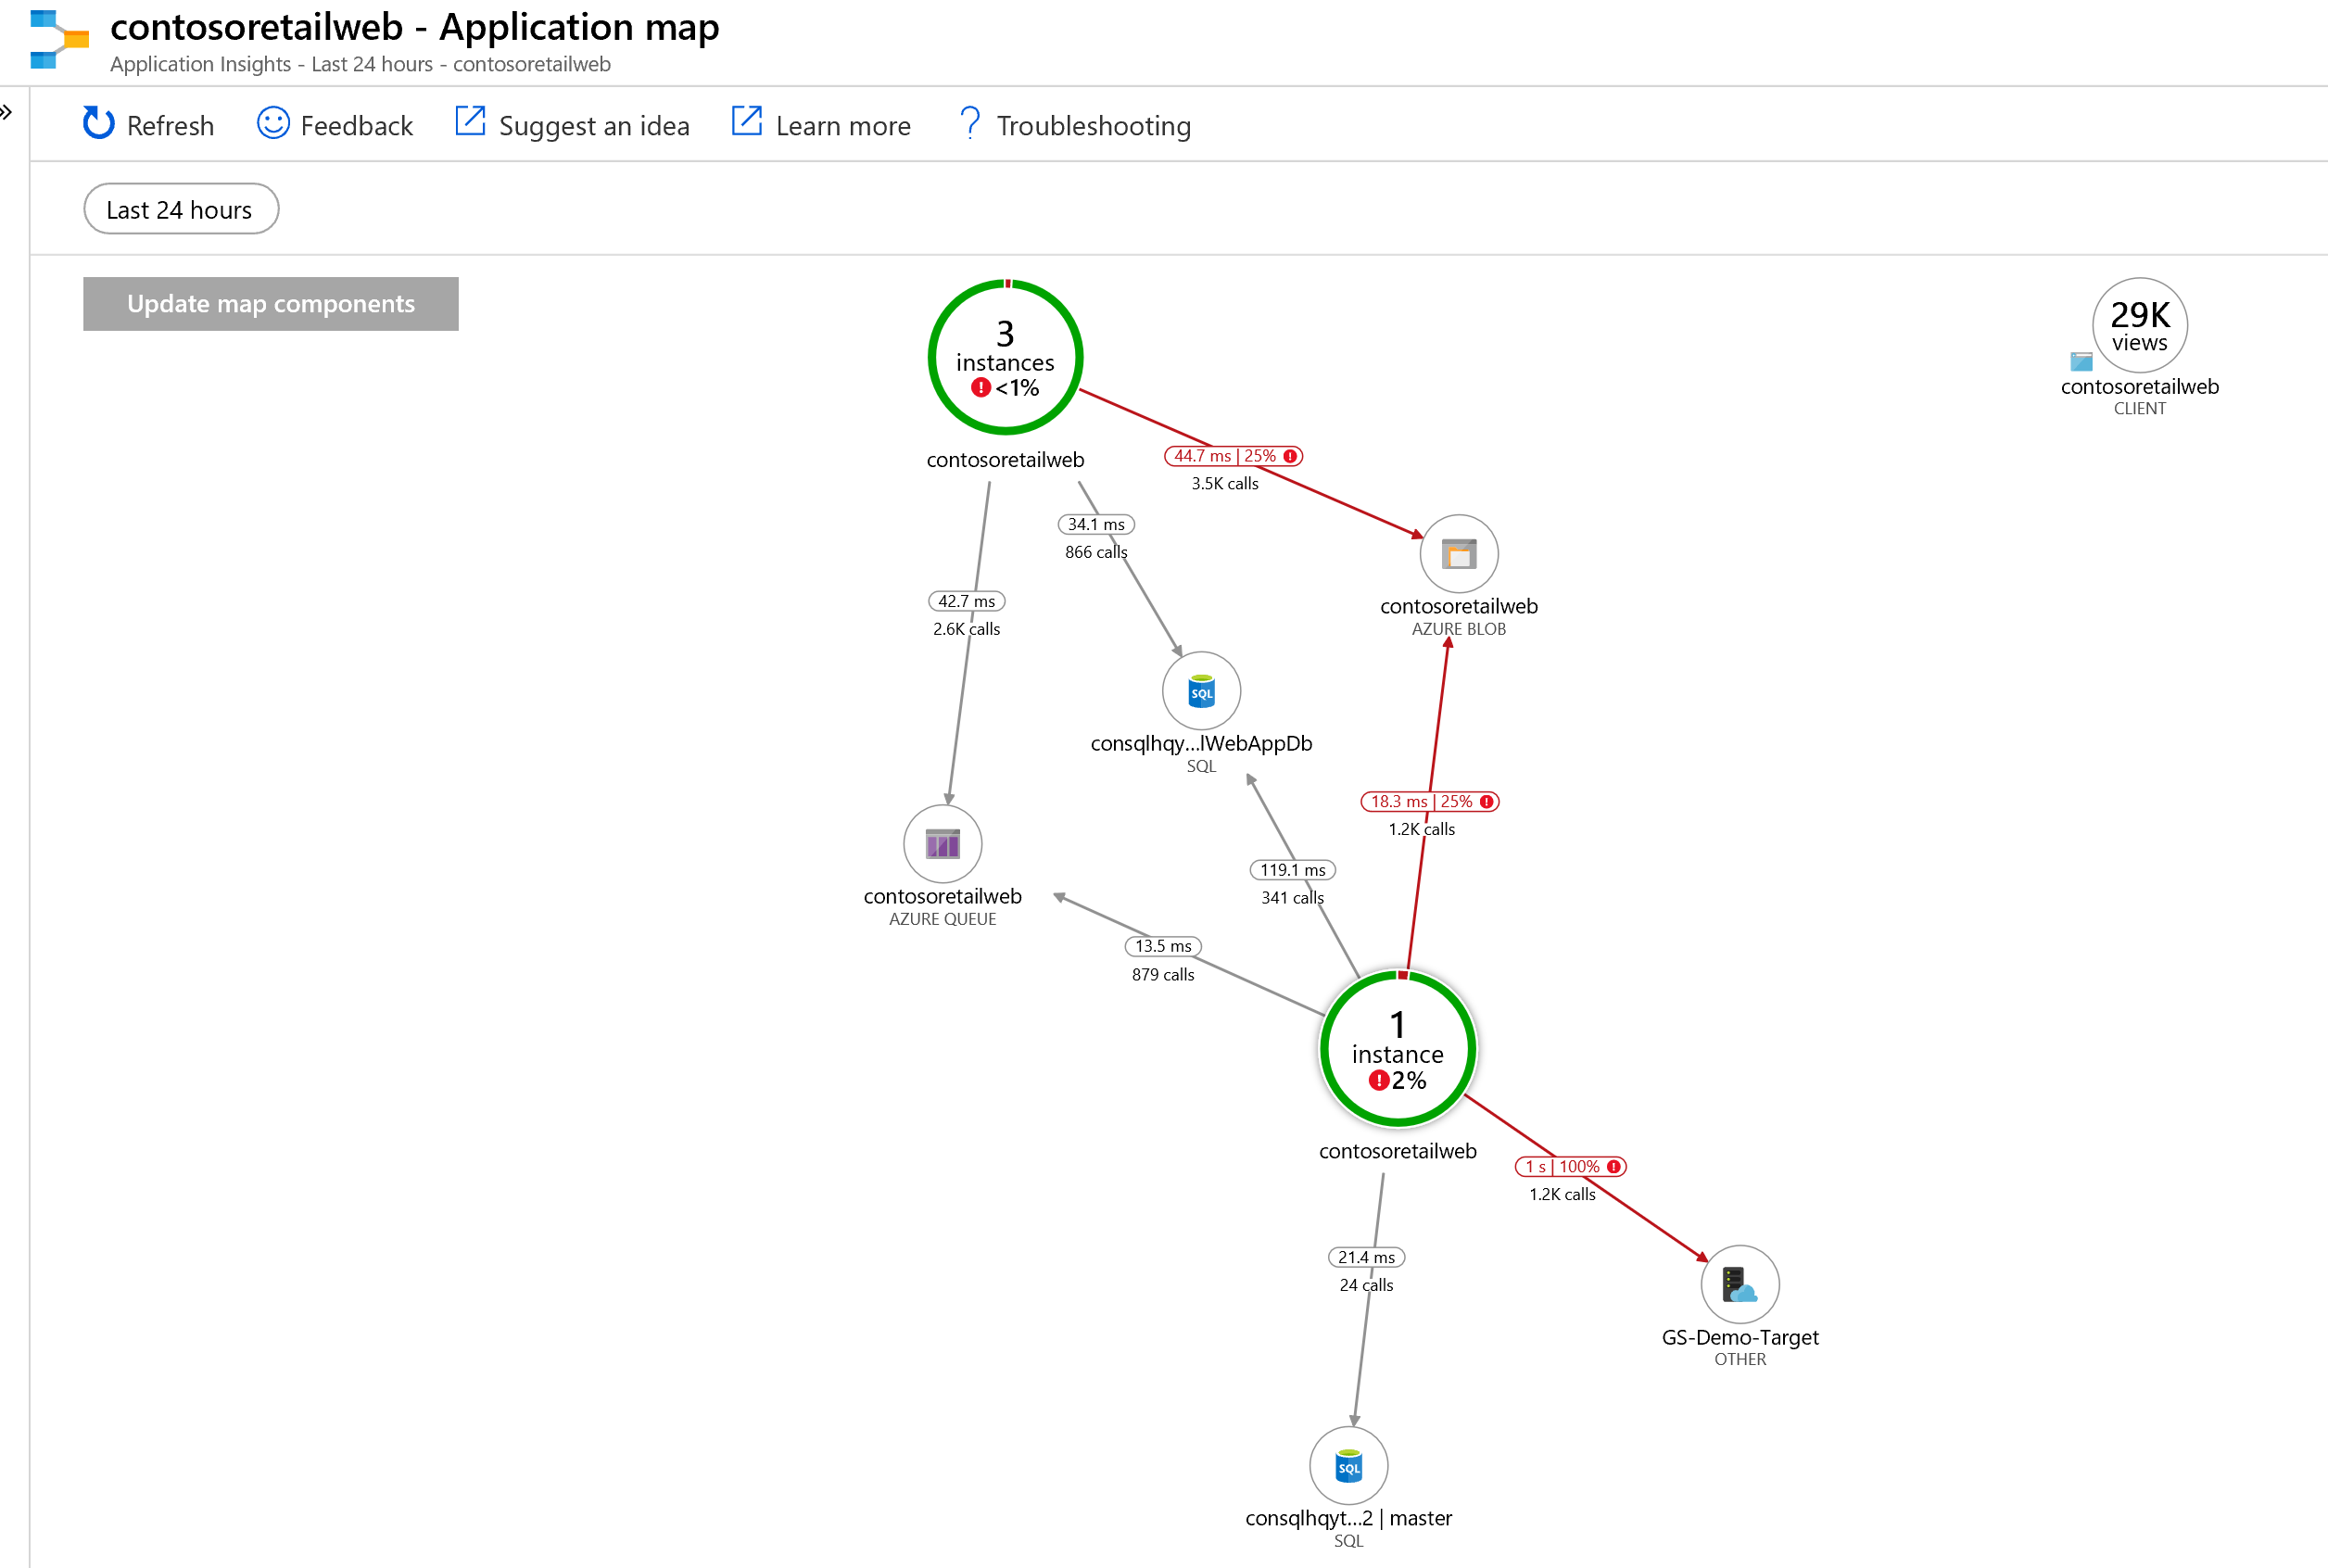
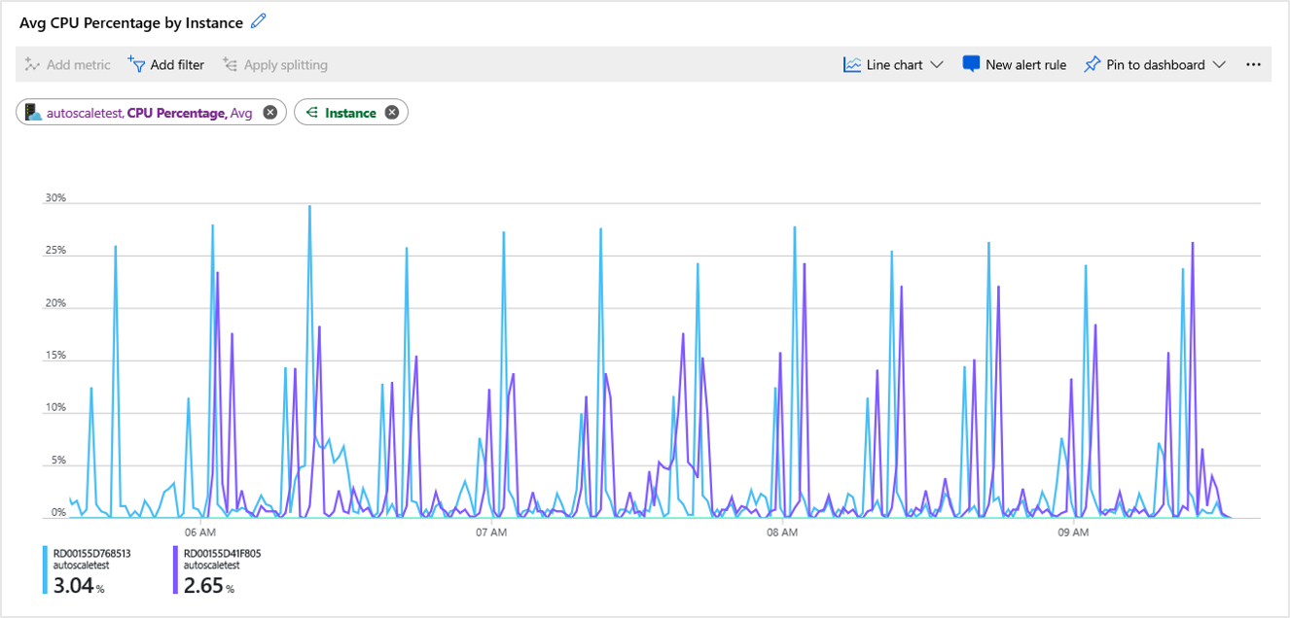
Consuming the Data
Notes:
App Insights Blade in Azure Portal
Application Map
Profiler
Metrics Explorer
Live Metrics
Visual Studio Extensions
Power BI
Continuous Export

Slide 17
Consuming Telemetry in Action
Demo

Slide 18
I have production issues

Slide 19
Reasons for Production Issues
Environment Configuration
Data Exposing Bugs in Code
Scaling Issues
Really Anything Else

Slide 20
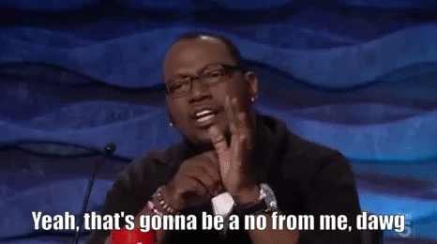
Triage Options
Copy Down Production Data to Local
Use Production Staging Environment
Read Logs (IIS, DB Logs, etc)
Attach Debugger to Prod.. NO, STOP, DO NOT PASS GO

Slide 21
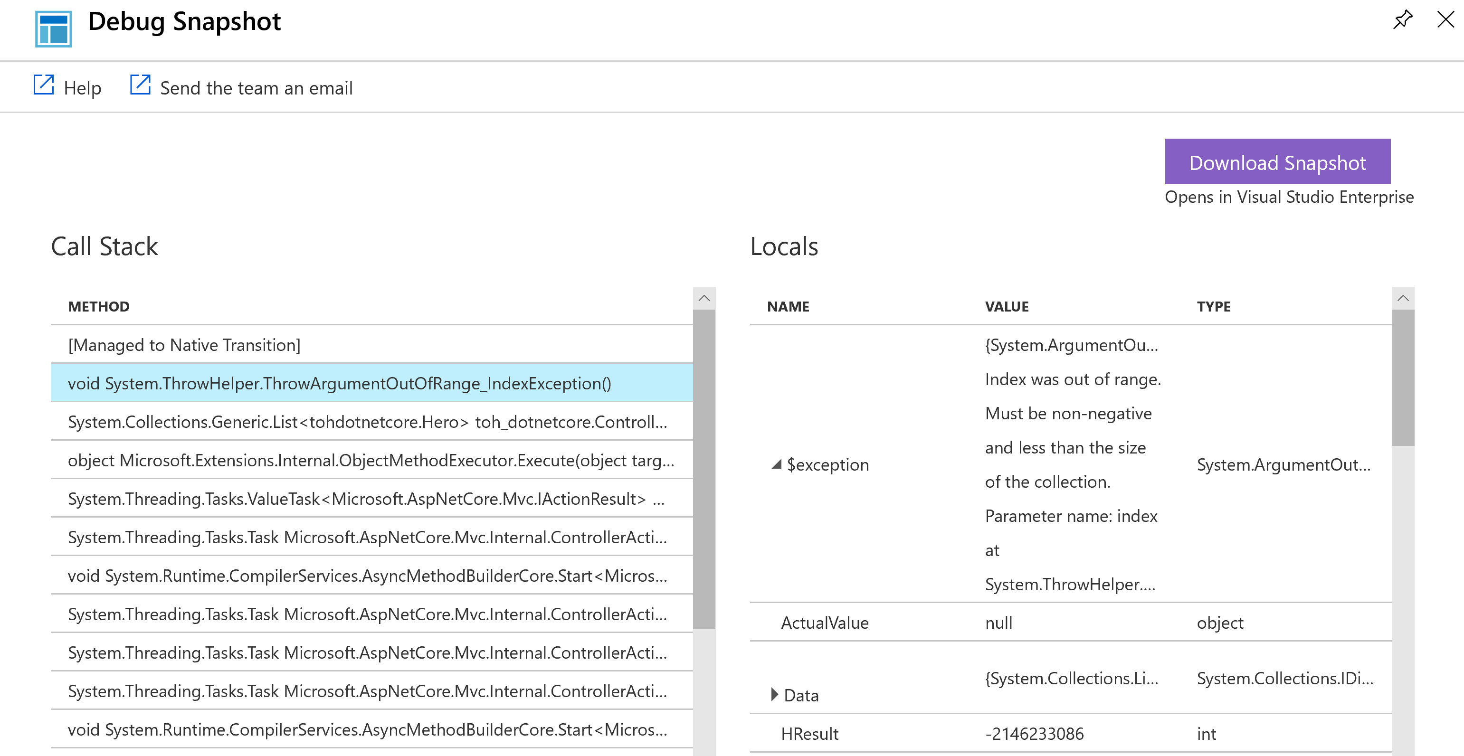
There has to be a better way?
Snapshot Debugger
Full Stack Trace
Locals window at time of Exception
Visual Studio Debugging detached from App

Slide 22
Snapshot Debugger/Exceptions
Demo

Slide 23
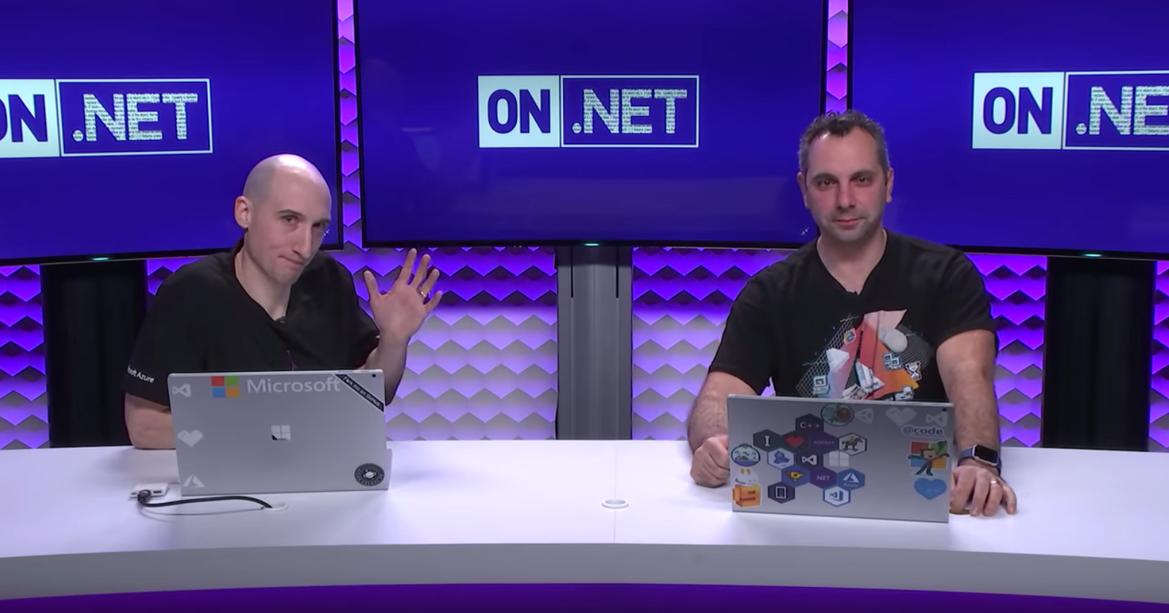
Watch Me on Learn TV!

Slide 24


Slide 25
http://isaacl.dev/appinsights-talk
Thank You! Any Questions?

